Slide 1


Opp Project presentation
Sir usama bin Shakeel

Slide 2


Group Members
Syeda Maham batool
Murtaza khalid
Syed kifayat ur rahman
This Photo by Unknown Author is licensed under CC BY-SA-NC

Slide 3
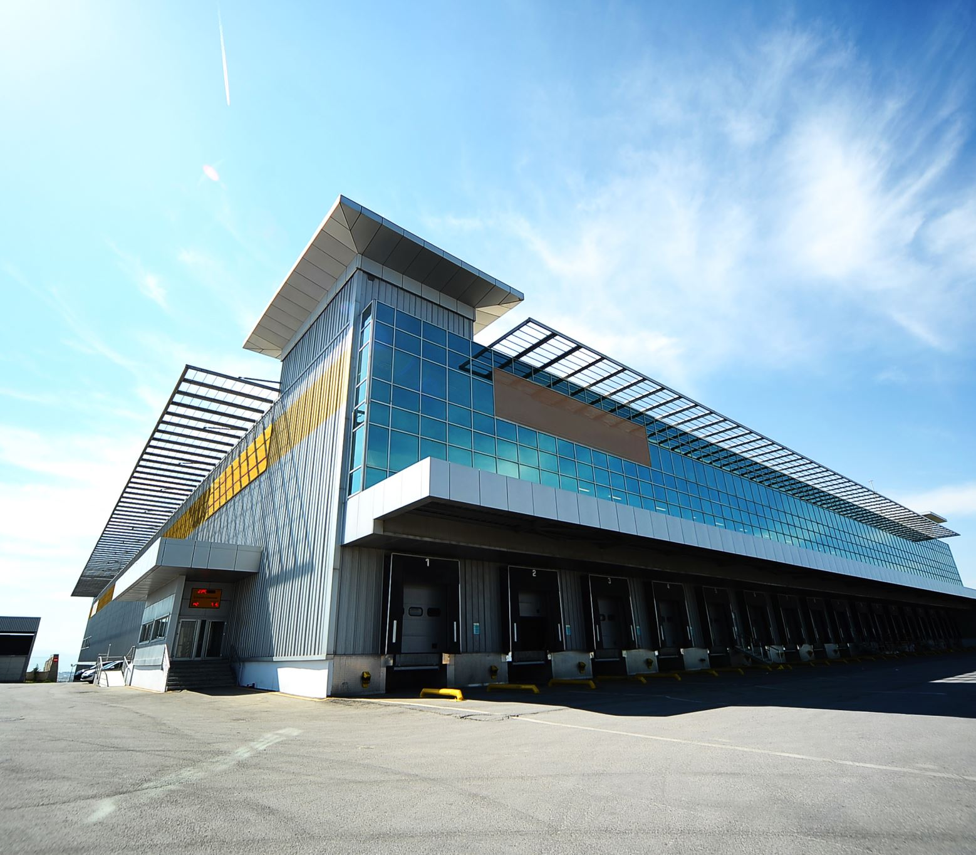
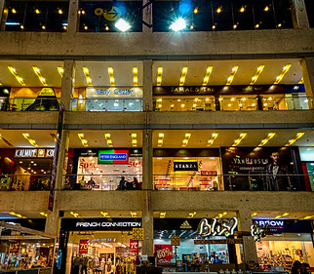
Mall management
Mall management system include all the operation and maintenance of entire building infrastructure which includes the management of accounts, shop, maintenance and parking. IT IS IMPORTANT TO DEAL WITH MANAGEMENT IN THIS ERA .WE GUYS DECIDED TO MADE MALL MANAGEMENT SYSTEM SO THAT IT ALSO HELP US TO DEAL WITH DIFFIRENT SCENARIOS .WE COME TO KNOW THAT HOW TO ORGANIZE OUR CODE AND SUMMARIZE OUR CODE USING CLASSES.
This Photo by Unknown Author is licensed under CC BY-NC-ND

Slide 4

Authorized persons
Head
Sub managers
Parking manager
Account manager
Maintenance manager
This Photo by Unknown Author is licensed under CC BY-NC

Slide 5
head
Basically, head act as the owner of the mall and have access to see the data of entire employees working in the mall. Head have access to following:
Account’s information
Maintenance details
Employee details
Parking details
Add managers
READ REPORT AND GIVE RESPONCE

Slide 6

Sub managers
Account manage
Parking manager
Maintenance manager
Shop manager
This Photo by Unknown Author is licensed under CC BY

Slide 7

Account manager
Account manager can manage the whole financial record of our mall.
Total revenue
Profit
Net amount
Employees salaries
maintenance budgets
READ MANGERS REPORT AND GIVE RESPONCE
REPORT
This Photo by Unknown Author is licensed under CC BY-SA

Slide 8
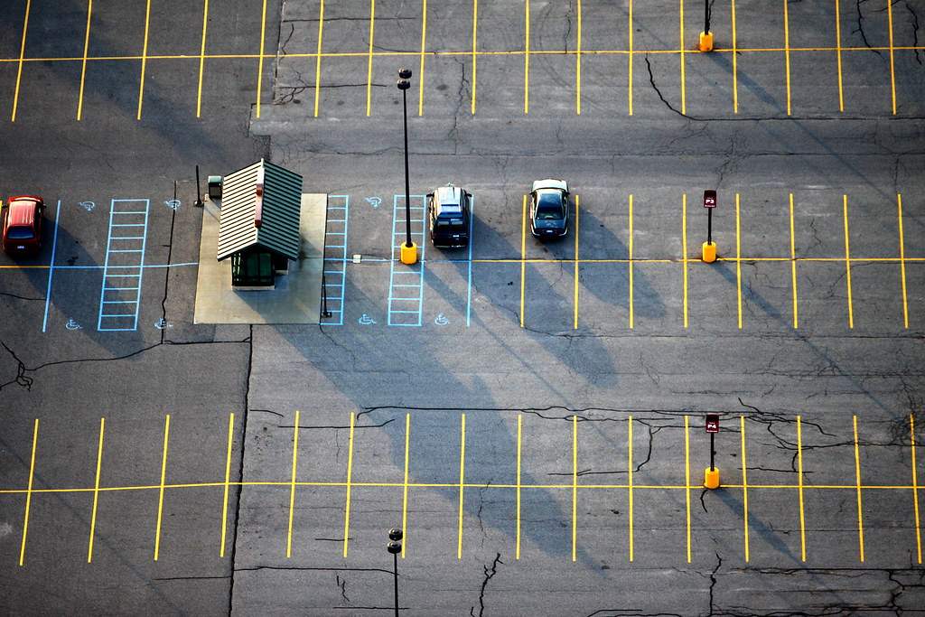
Parking manager
Vehicle type
Vehicle registration number
Vehicle entry
Vehicle disentry
REPORT AND READ RESPONSE
This Photo by Unknown Author is licensed under CC BY-ND

Slide 9
Maintenance manager
Add employees
reports AND READ RESPONCE
Read maintenance details
MAINTENANCE BUDGET

Slide 10
SHOP MANAGER
ADD SHOPS
ADD OWNER
REPORT AND READ RESPONSE
READ DETAILS

Slide 11
TASK LIST
Syeda Maham Batool
SYED KIFAYAT UR RAHMAN
MURTAZA KHALId
Parking class
Report class
Employee class
Total income class
Maintenance class
Electricity class
Account class
Details class
Shop class
Calculator class

Slide 12
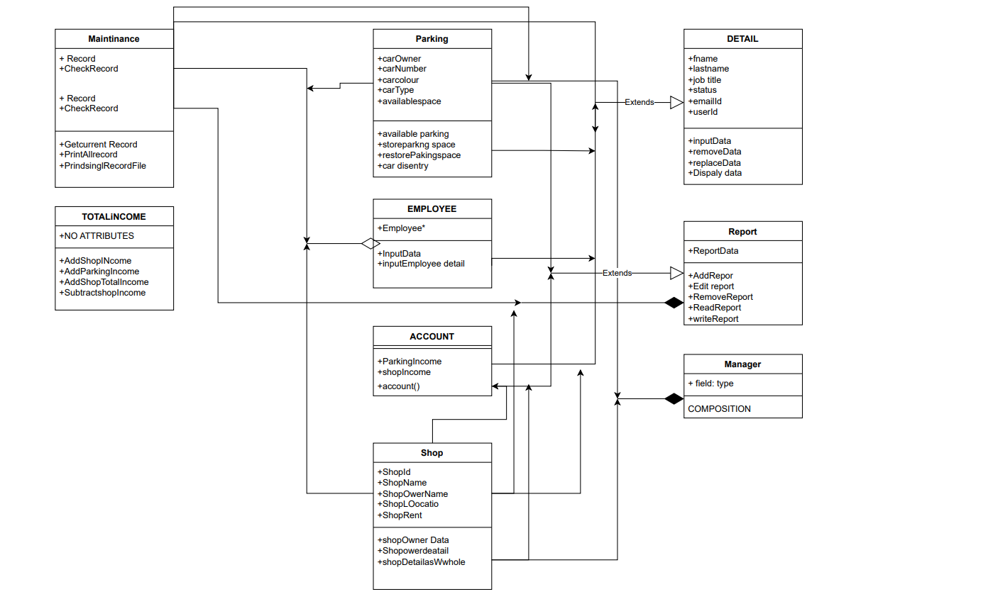

Slide 13
